Slide 1
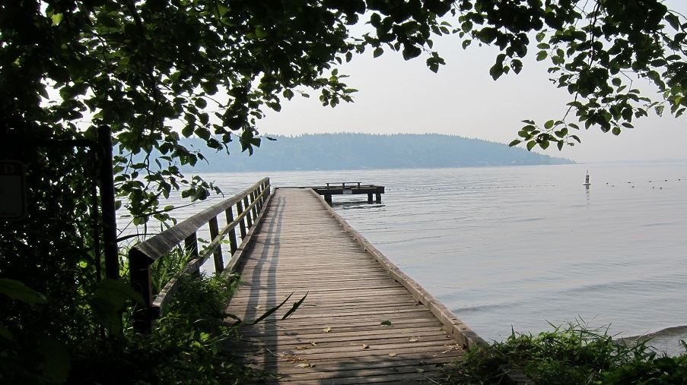


City of Lake Forest Park
Shoreline Master Program
Periodic Update
May 22, 2019
Photo credit: en.Wikipedia.org

Slide 2
What is a Shoreline Master Program (SMP)?
An SMP is a set of policies and regulations required by state law that has three basic principles:
      Protect the environmental resources of state shorelines
      Promote public access and enjoyment opportunities
      Give priority to uses that require a shoreline location
The City comprehensively updated its SMP in 2013
The SMP is referenced in Lake Forest Park Municipal Code (LFPMC) 16.18

Slide 3
Where does an SMP apply?
Applies to “Shorelines of the State,” which are waterbodies that meet certain criteria
As relevant to Lake Forest Park, this includes:
      Lakes > 20 acres → Lake Washington
In Lake Forest Park, shoreline jurisdiction includes land within 200 feet of these waterbodies, as well as any associated wetlands and floodplain

Slide 4
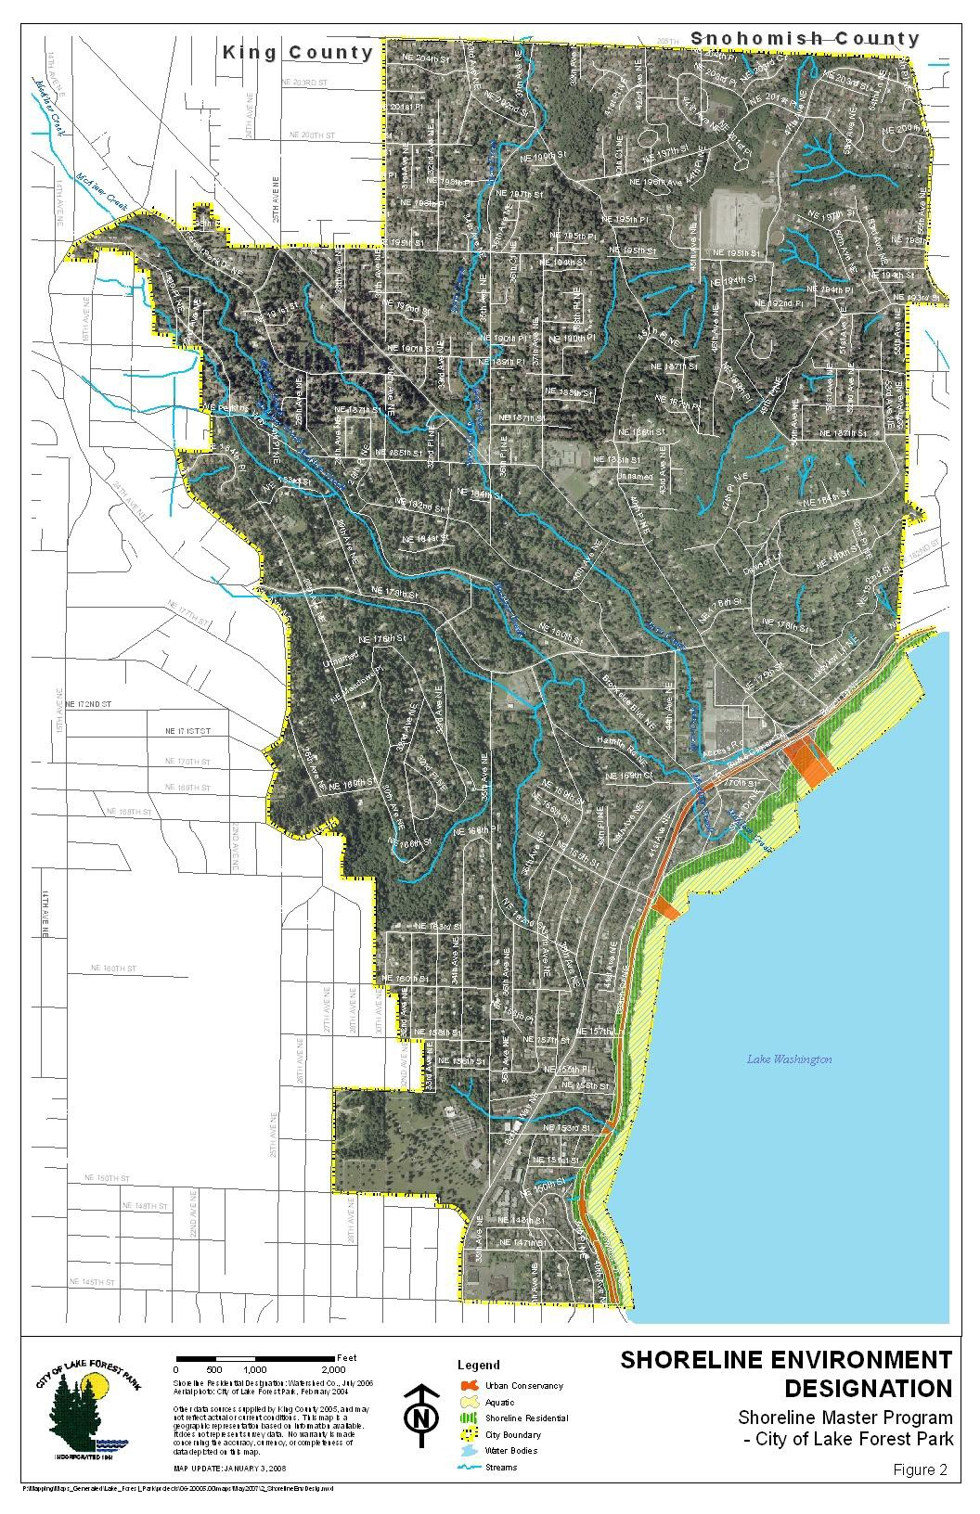
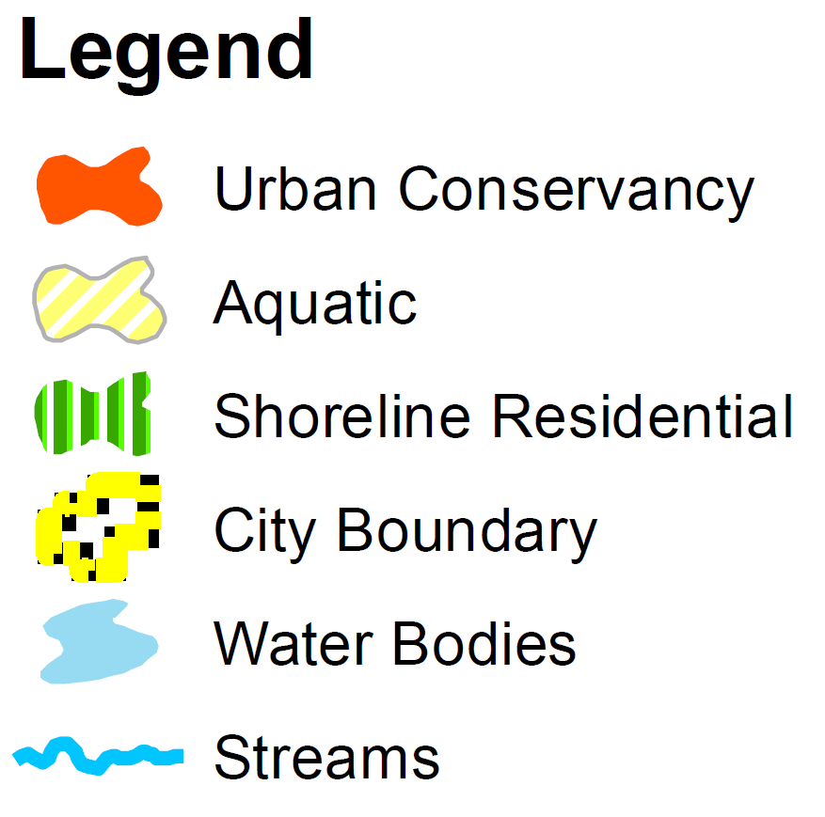
Shoreline Environment Designations
-
^
<- <- <- Shoreline Jurisdiction

Slide 5
What is an SMP periodic update?
The state requires all SMPs to be reviewed every eight years
Periodic review is intended to keep SMPs current with:
      Amendments to state laws
      Changes in local plans and regulations
      New or improved data and information

Slide 6
The SMP periodic update will not:
Re-evaluate the ecological baseline which was established as part of the 2013 comprehensive update
Extensively assess no net loss criteria other than to ensure that proposed amendments do not result in degradation of the baseline condition
Change shoreline jurisdiction or environment designations

Slide 7
Gap Analysis Report Purpose
Consistency with:
    1. State legislative amendments
    2. Current critical areas regulations
        Ecology Best Available Science recommended revisions
    3. Comprehensive Plan &municipal code (development regulations)
    4. Additional issue(s) to consider
Photo Credit: Google Earth © 2018

Slide 8
Proposed amendments
Definitions
Updating definitions to be consistent with those in state law
    Development, Nonconforming definitions as examples
Exemptions
Updating development & residential pier cost thresholds and ADA allowances per state law
Cross-references
      Adding cross-references with other state and local regulations to help users navigate the code
Green roofs – eliminating this shoreline buffer reduction provision

Slide 9
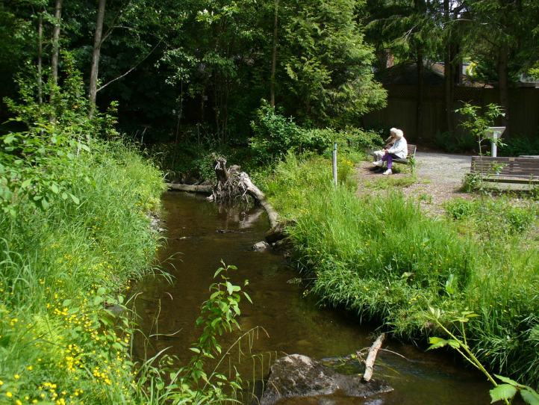
Proposed amendments, Critical Areas
Adopt by Ordinance the most recent critical area regulations in LFPMC 16.16
Wetlands
  Revising existing wetland buffers consistent with the most recent guidance from the Washington State Department of Ecology
        Buffers would be either the same or smaller in all cases

Slide 10
Timeline
Open House – May 22nd 2019
Joint Ecology\City public comment period – June – July 2019
Joint Ecology\City public hearing – July 2019
Local adoption by City Council – late summer – early fall 2019

Slide 11
Additional information
Project website:
  https://www.cityoflfp.com/159/Shoreline-Master-Program
  Staff contact is Steve Bennett, Planning Director
    (206) 957-2812
    sbennett@ci.lake-forest-park.wa.us

Slide 12
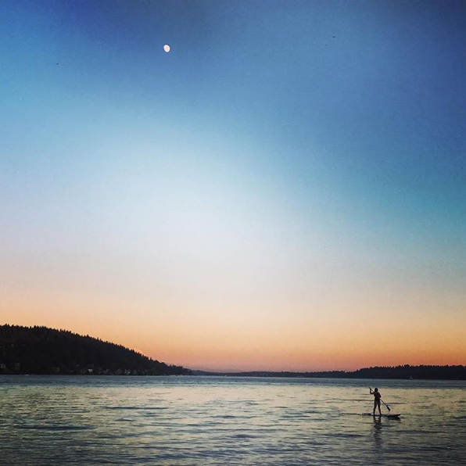
Thanks for listening−questions?
Thanks for listening−questions?
Photo credit: shawn.edmondson (Instagram)

